Slide 1
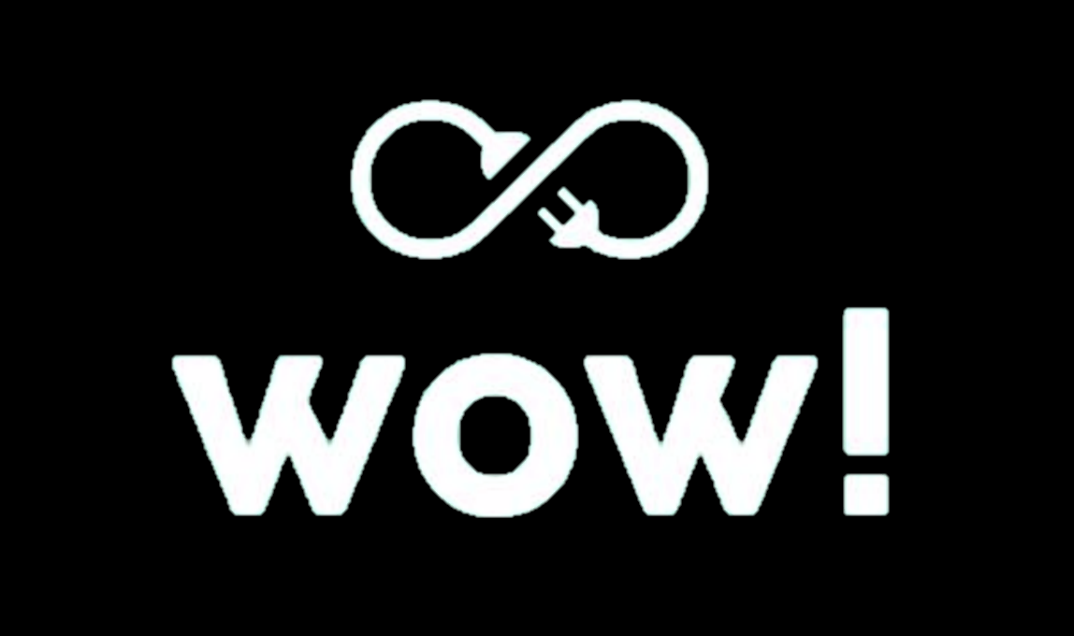
INVESTING IN U.S.
WIND POWER
TEAM JADEN DAI01

Slide 2





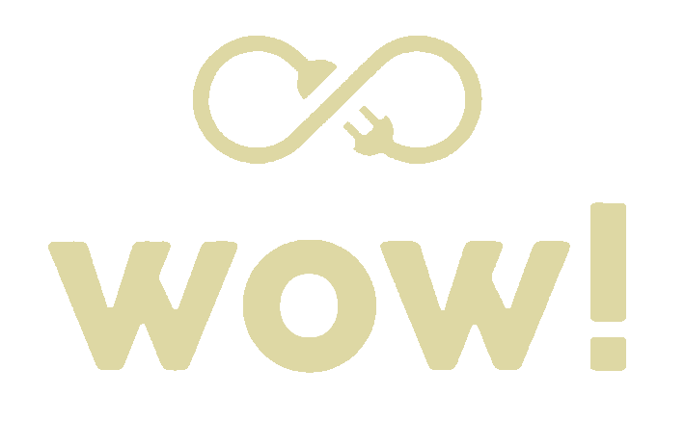
ABOUT US
Janisse Koh
Avan Quak
We are Team JADEN from WOW!, a Chicago-based private equity firm specialising in clean energy investments.
Currently, our portfolio includes U.S. hydropower projects, and we are exploring potential investments in U.S. wind power.
Daniel Lee
Er Ning
Nicholas Leong

Slide 3

OBJECTIVE
The objective of this project is to evaluate the potential for WOW! to invest in the U.S. wind turbine market. The research will explore current and future growth outlook, investment opportunities and potential partner(s) to inform the decision of whether WOW! should enter this market.

Slide 4





AGENDA
1
4
US Wind Generation Market
Partner Selection & Investment Plan
2
5
Growth Outlook for Wind in U.S.
Reflection
3
Identifying Investment Opportunities

Slide 5
U.S. Power Generation Market Overview

Slide 6
Market Sizing
Total Addressable Market
Global renewable energy market size: US$1,031b (2022)
CAGR: 8.6% (2022-2030)
Serviceable Available Market
Global wind energy market size: US$78b (2021)
CAGR: 9.4% (2021-2030)
Serviceable Obtainable Market
US wind energy market size: US$19b (2020)
CAGR: 5.9% (2022-2027)
Notes:
https://www.precedenceresearch.com/renewable-energy-market
https://www.precedenceresearch.com/wind-energy-market
https://www.mordorintelligence.com/industry-reports/united-states-wind-energy-market#:~:text=The%20US%20wind%20energy%20market%20is%20expected%20to%20register%20a,around%2014%20GW%20in%202020.

Slide 7
Energy generation from hydropower is stagnant. Biggest opportunity comes from wind energy with exponential growth since 2007.
Source: Statistical Review of World Energy - BP (2022)
Notes:
Hence we should pivot from existing hydropower investments to wind power.
Source:
https://ourworldindata.org/grapher/renewable-energy-gen
https://ourworldindata.org/grapher/modern-renewable-energy-consumption?country=~USA

Slide 8
Wind power makes up 30% of total capacity additions in U.S. over the last decade, second only to solar power in 2021.
40%
6%
24%
38%
26%
24%
20%
32%
42%
32%
Source: U.S. Department of Energy, Office of Energy Efficiency and Renewable Energy
Notes:
Over the last decade, wind represented 30% of total capacity additions.
Wind power represented the second largest source of U.S. electric-power capacity additions in 2021, at 32%, behind solar’s 45%.
Natural gas and other non-renewable capacity additions continued their recent decline, falling to their lowest level in more than 20 years
Source: https://emp.lbl.gov/sites/default/files/2022_land_based_wind_market_report_ppt.pdf

Slide 9
Globally, U.S. ranked 2nd in annual and cumulative total wind power capacity additions in 2021.
Annual Capacity (2021, GW)
China | 47.6
United States | 13.4
Brazil | 3.8
Vietnam | 3.5
United Kingdom | 2.6
Sweden | 2.1
Germany | 1.9
Australia | 1.7
India | 1.5
Turkey | 1.4
Rest of World | 14.7
Total | 94.3
Cumulative Capacity (2021, GW)
China | 338.3
United States | 135.9
Germany | 64.5
India | 40.1
Spain | 28.3
United Kingdom | 26.6
Brazil | 21.6
France | 19.1
Canada | 14.3
Sweden | 12.1
Rest of World | 138.1
Total | 838.9
Global wind additions totalled over 94 GW of newly added capacity
U.S. remains a distant second to China in annual and cumulative capacity.
Source: U.S. Department of Energy, Office of Energy Efficiency and Renewable Energy
Notes:
Globally, the United States again ranked second in annual wind capacity, but remained well behind the market leaders in wind energy penetration. Global grid-connected wind additions totaled 94 GW in 2021, yielding a cumulative 839 GW. The United States remained the second-leading market in terms of annual and cumulative capacity, behind China.
Source: https://emp.lbl.gov/sites/default/files/2022_land_based_wind_market_report_ppt.pdf

Slide 10
U.S. ranks lower than many other countries in terms of wind energy as a share of total generation at only 9%
Source: U.S. Department of Energy, Office of Energy Efficiency and Renewable Energy
Notes:
A number of countries have achieved high levels of wind penetration, with wind supplying 44% of Denmark’s total electricity generation in 2021, and over 20% in Ireland, Portugal, Spain, Germany, and the U.K. In the United States, wind supplied 9.1%.
Source: https://emp.lbl.gov/sites/default/files/2022_land_based_wind_market_report_ppt.pdf

Slide 11
Growth Outlook for Wind in U.S.

Slide 12
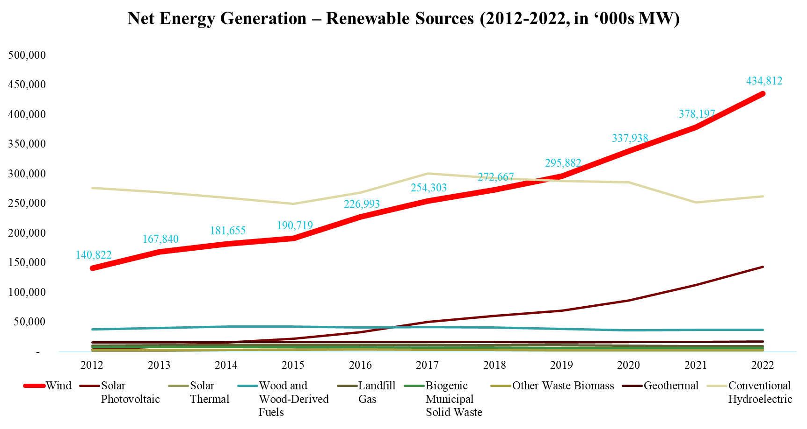
Among renewable sources of energy, Wind is growing the fastest at a CAGR of 11% from 2012 to 2022.

Slide 13
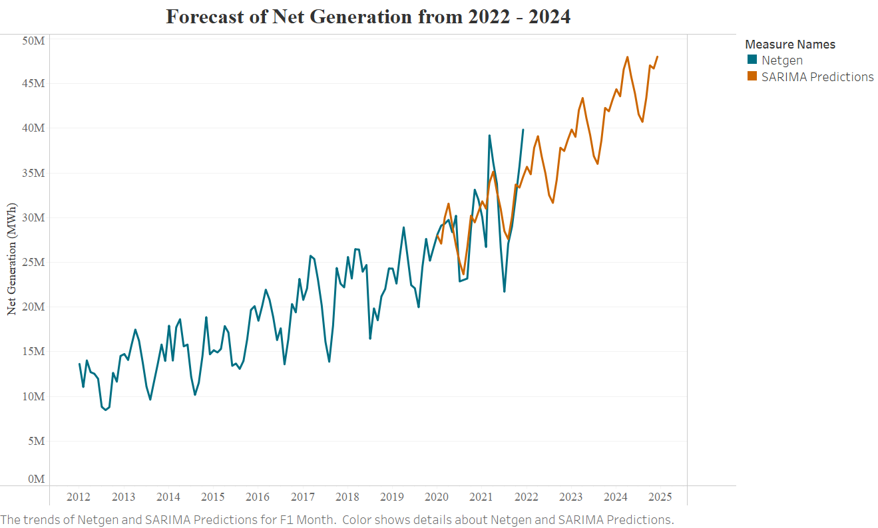
Consistent with historical trend, our SARIMA prediction shows positive growth for the wind power market at least for the next 3 years.
MSE = 2.935M MWh
Forecasted % growth
Year 2022 – 14.1%
Year 2023 – 12.0%
Year 2024 – 11.6%

Slide 14
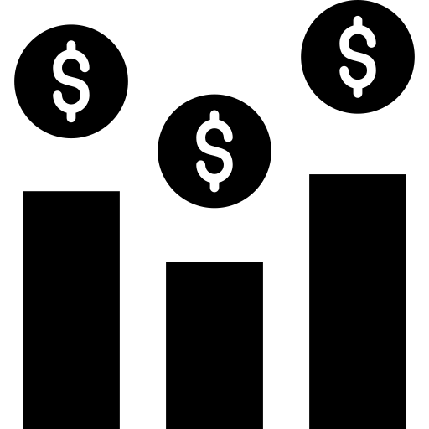
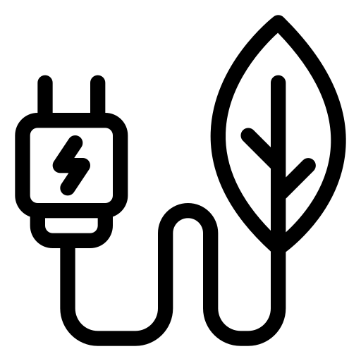
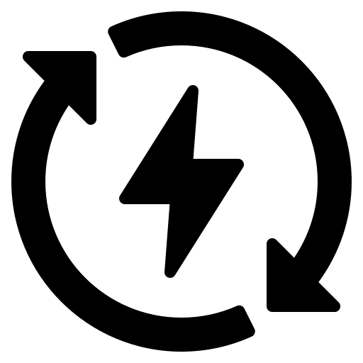
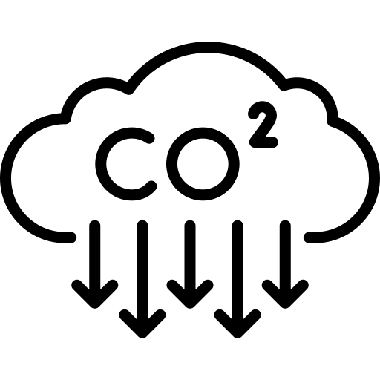
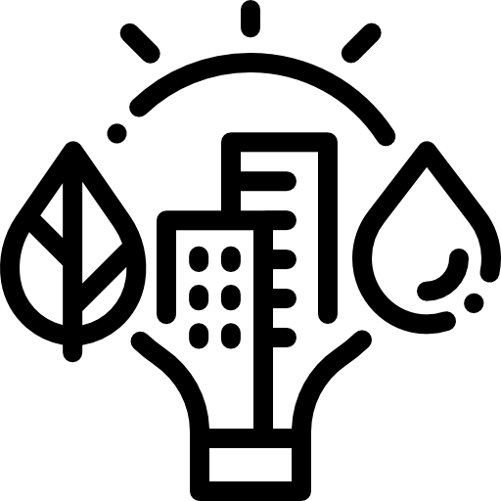

Growth Drivers of Wind Energy in U.S.
Cost competitiveness | Federal clean energy policies | State clean energy policies
Fuel costs for conventional generation rising faster than renewable costs. | Inflation Reduction Act (IRA) - tax credits for wind and solar projects built before 2025 and technology-neutral credits through 2032. | More than 22 states targeting 100% renewable energy or 100% carbon-free electricity by 2050.
Utility decarbonisation | Corporate procurement | Rising private investment
96% of the largest US investor-owned utilities committed to reducing carbon emissions by boosting renewables | RE100 renewable electricity initiative – more than 380 global businesses committed to 100% clean electricity | Investors attracted by transparent returns on mature technologies backed by 10-year tax credits with direct pay options.
Notes:
In 2022, US renewable energy growth slackened its pace due to rising costs and project delays driven by supply chain disruption, trade policy uncertainty, inflation, increasing interest rates, and interconnection delays.1 Many of these challenges will likely carry over into 2023, creating strong headwinds. But growth will likely accelerate powered by robust demand and the record-breaking raft of clean energy incentives in the Inflation Reduction Act (IRA).
Cost competitiveness. While renewable energy costs may continue to rise temporarily in 2023 due to ongoing supply chain challenges, wind and solar will likely remain the cheapest energy sources in most areas, as fuel costs for conventional generation have been rising faster than renewable costs.
Federal clean energy policies. Among other supportive provisions, the IRA extends wind and solar tax credits for projects that begin construction before 2025 and technology-neutral credits through at least 2032.5 Projections suggest the law will spur 525 to 550 GW of new US utility-scale clean power by 2030.
State clean energy policies. Twenty-two states and the District of Columbia are targeting 100% renewable energy or 100% carbon-free electricity, often through clean and renewable energy mandates and incentives, with target dates between 2040 and 2050.
Utility decarbonization. As of October 2022, 43 of the 45 largest US investor-owned utilities have committed to reducing their carbon emissions, and boosting renewables is one of their key strategies for meeting those commitments.
Corporate renewable procurement spurred a record 11 GW of US clean energy installations in 2021 and is set to exceed that in 2022.9 More than 380 global businesses have committed to 100% clean electricity by joining the RE100 renewable electricity initiative, up from about 200 in 2019.
Private investment in renewables hit a record high of $10 billion in the past year. That could continue, as investors are attracted by transparent returns on mature technologies backed by 10-year tax credits with direct pay options.
Growing demand in 2023 could exacerbate supply chain constraints and interconnection bottlenecks, further boosting prices and extending project timelines. And transmission limitations could continue to hamper growth until capacity is significantly expanded. But the evolving trends and opportunities that follow could help the industry navigate headwinds as it grows in 2023 and set the stage for faster growth in 2024.
Source: https://www2.deloitte.com/us/en/pages/energy-and-resources/articles/renewable-energy-outlook.html

Slide 15
Identifying Investment Opportunities

Slide 16
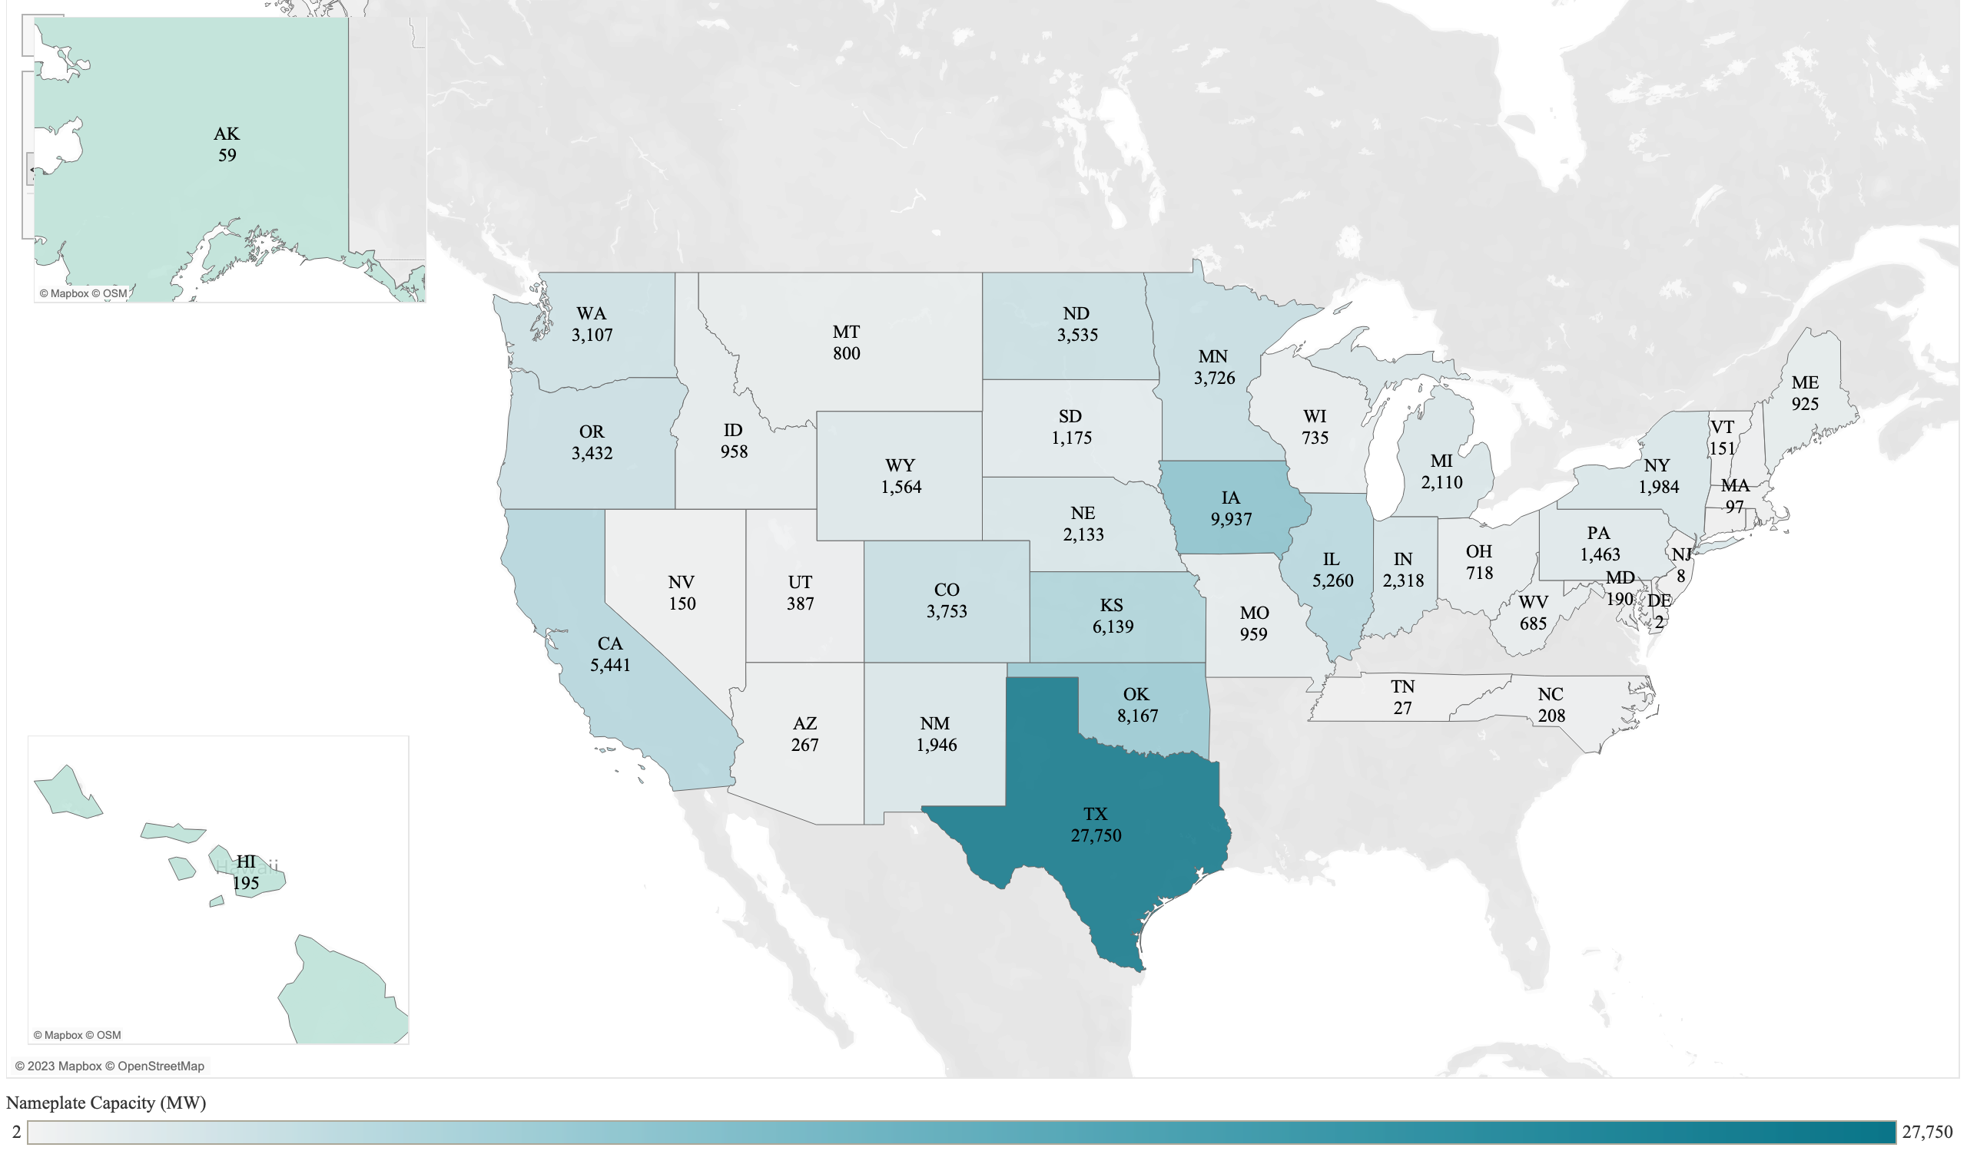
Currently, Texas, California and Iowa have the highest wind capacity

Slide 17
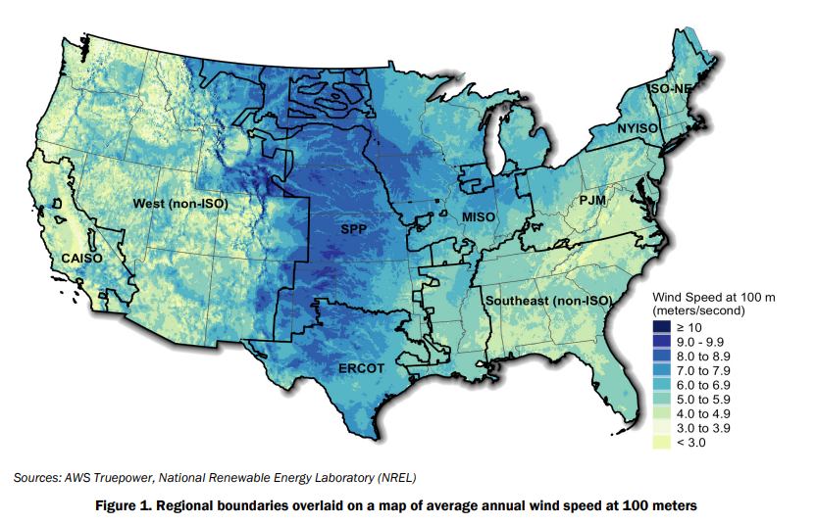
75% of new wind capacity installed in 2021 is located in the middle part of U.S. where wind speed are the highest.

Slide 18
Caveats
Focusing only on onshore wind turbine projects in the U.S. in operation as of 2021
Projects with 2 years of operation or less were excluded from analysis

Slide 19
Key Evaluation Metrics
Uptime | Net Generation / Total Capacity ⬆
Uptime Rate | Uptime CAGR ⬆
Efficiency | Total Consumption / Net Generation ⬇
Efficiency Rate | Efficiency CAGR ⬇
To get an overview of the plants’ performance, we clustered them based on:
Uptime, Uptime rate
Efficiency, Efficiency rate
Average turbine specifications (net generation, fuel consumption, capacity) divided by the number of turbines respectively

Slide 20
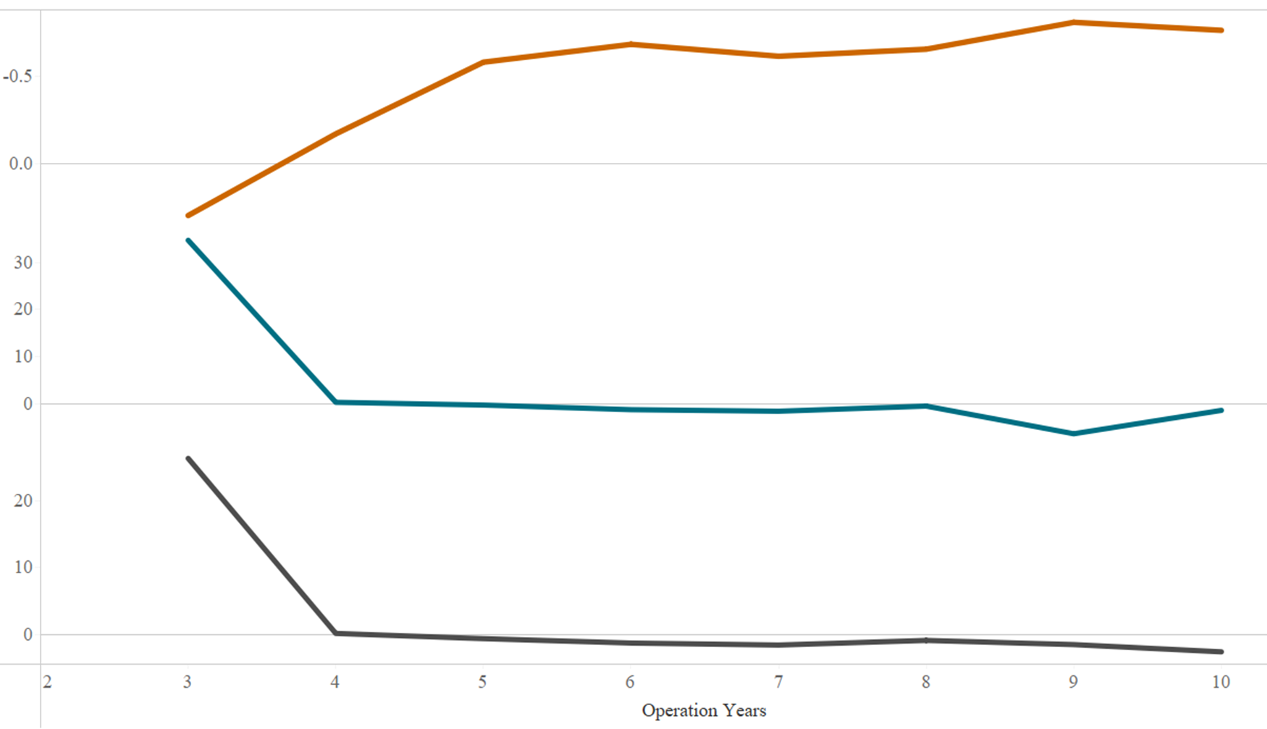
Older wind farms have higher efficiency growth rate and lower net generation and uptime growth rate.
Avg. Efficiency CAGR
Avg. Net Generation CAGR
Avg. Uptime CAGR

Slide 21
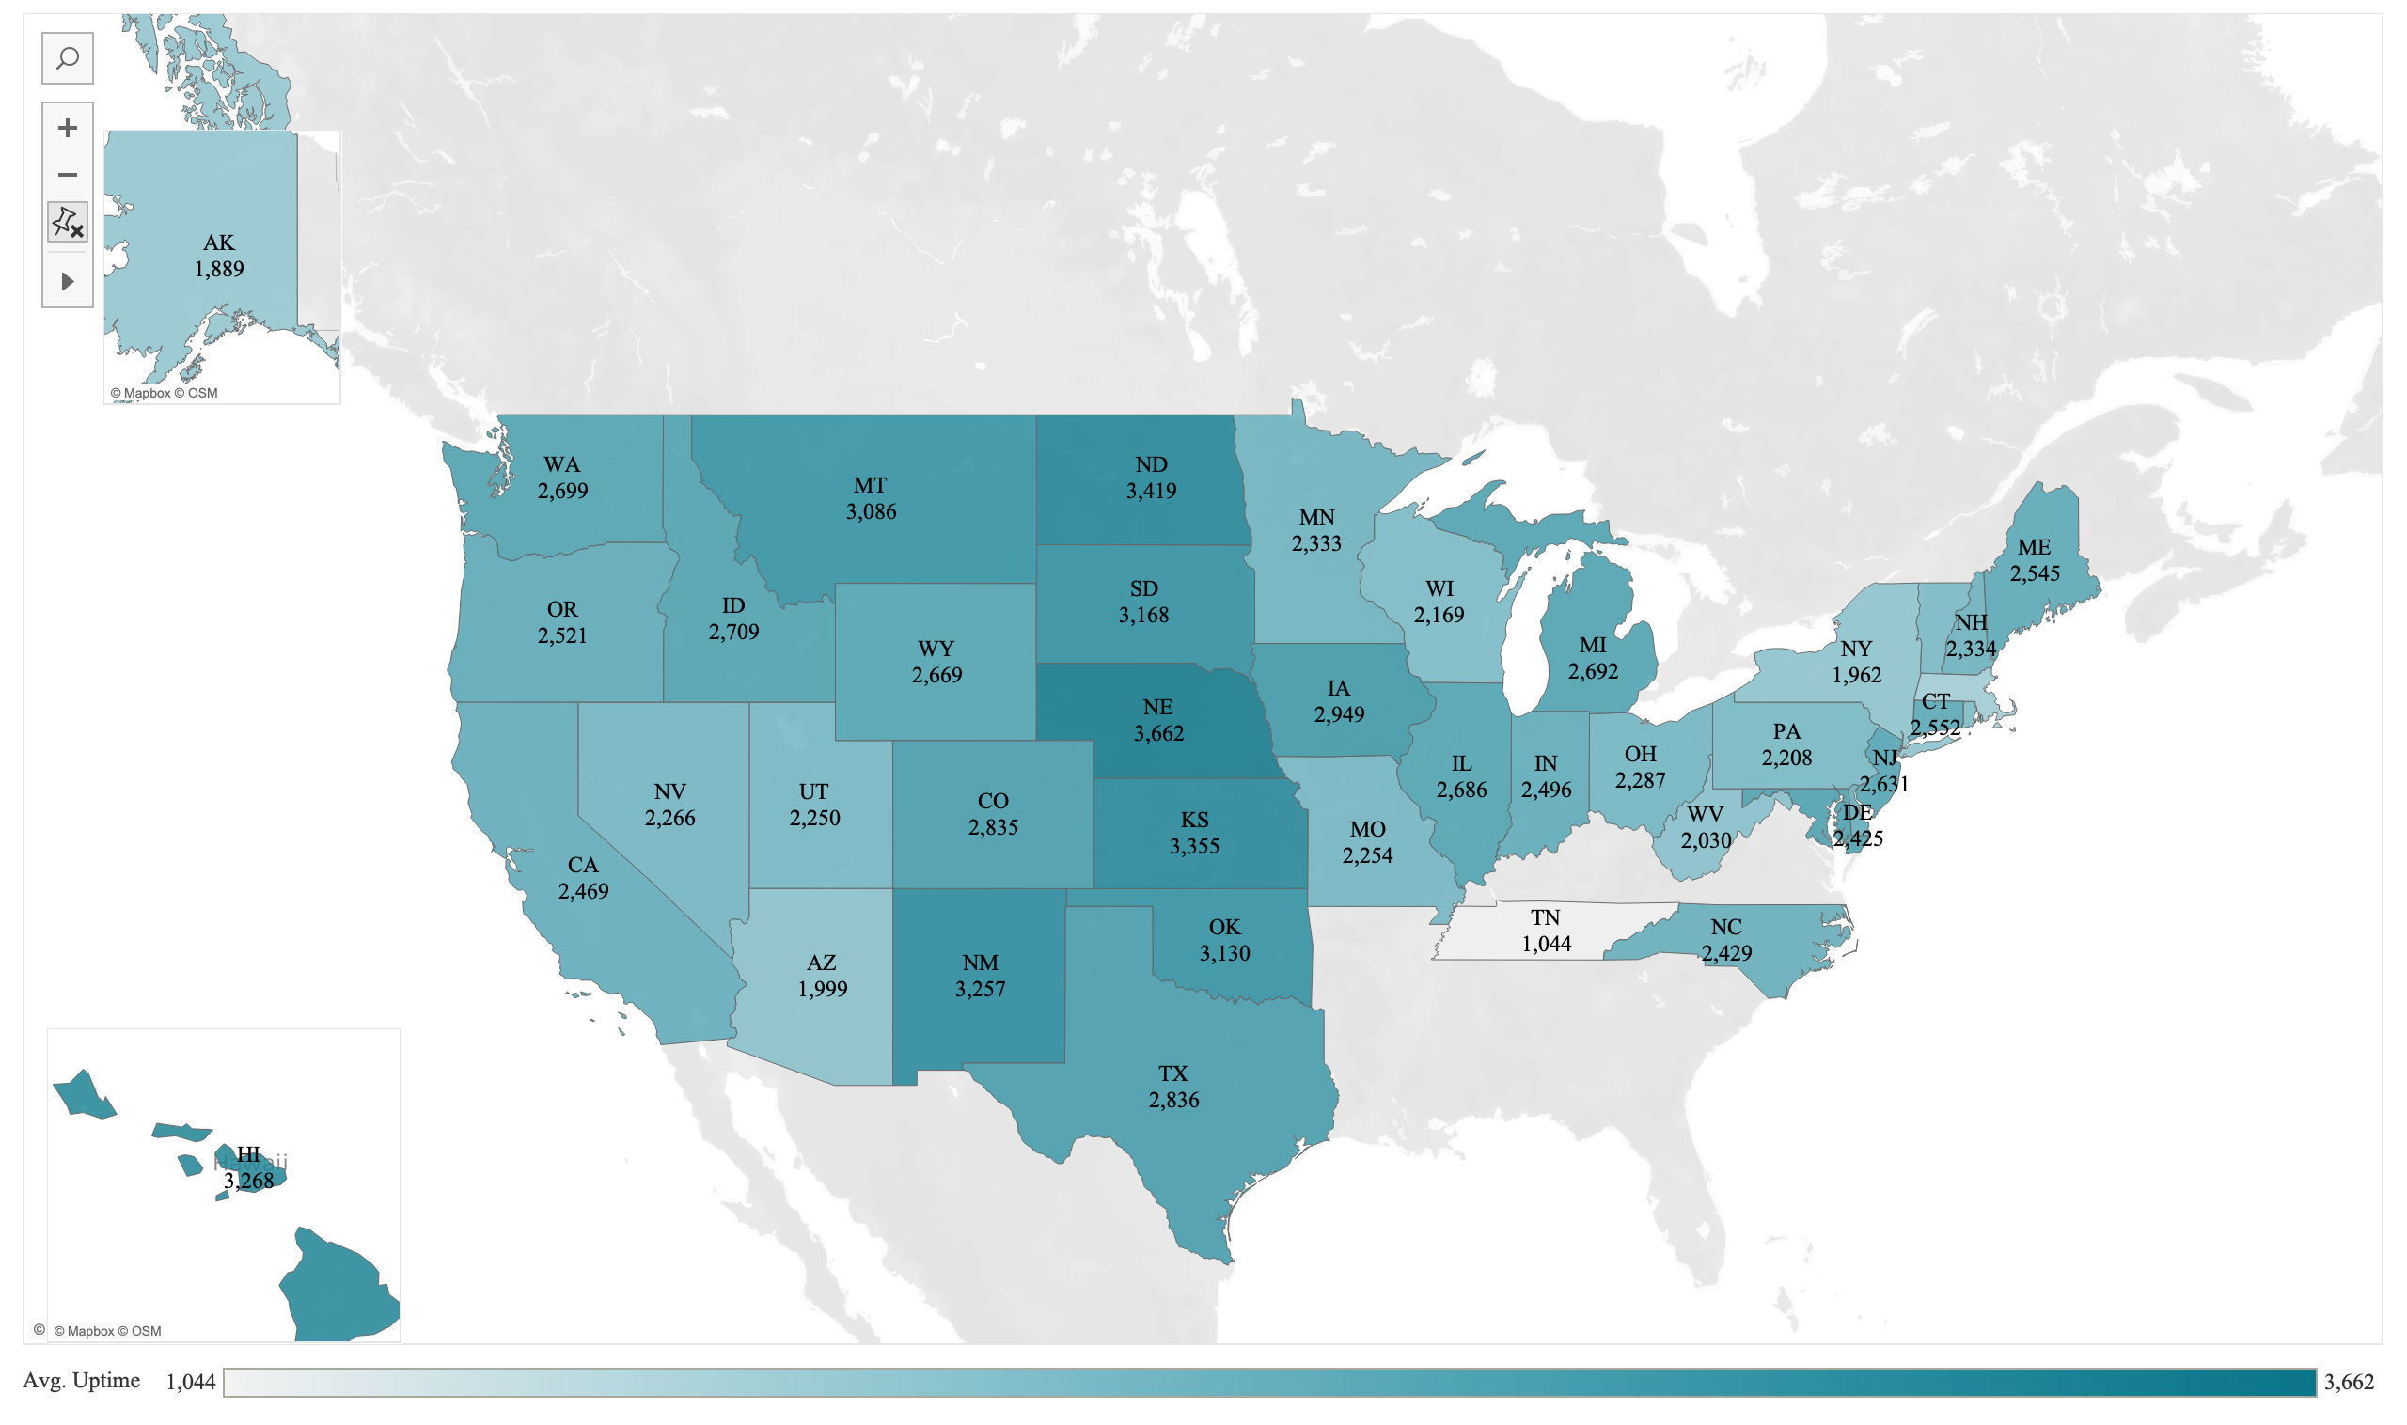
States with the highest wind speed also have the highest uptime*
* Uptime = Net generation / Plant capacity

Slide 22
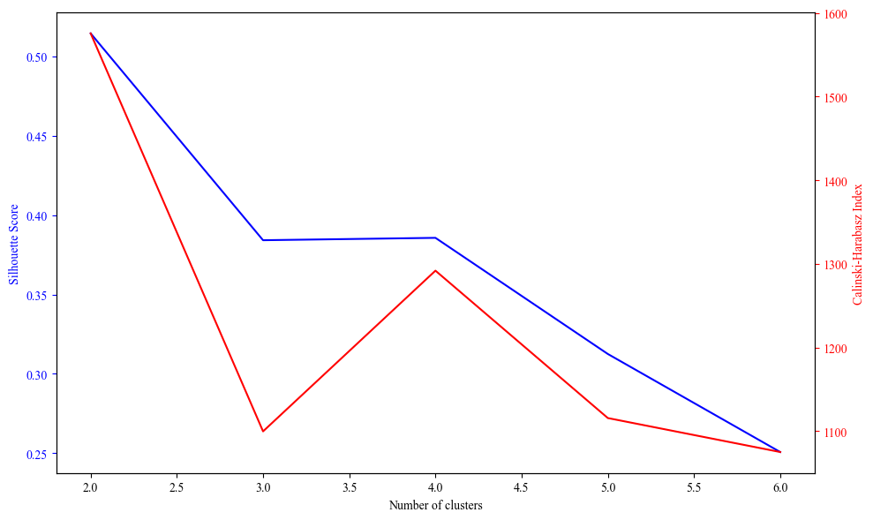
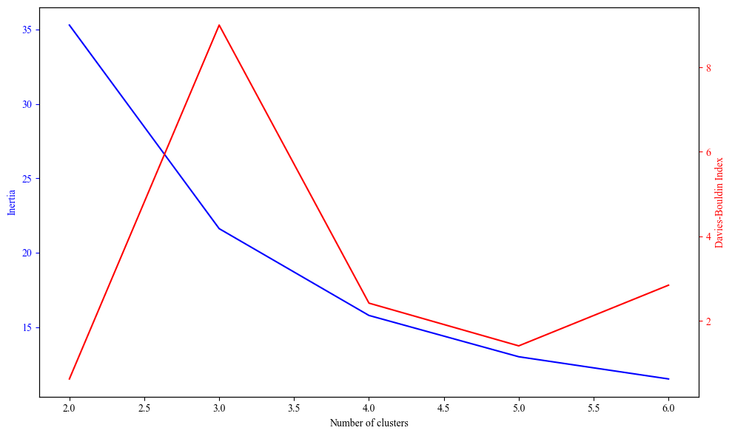
The ideal number of cluster is k=2
Energy plant metrics were grouped into ‘k’ clusters based on sklearn’s evaluation metrics for unknown labels.
K = 2
K = 2
Silhouette Coefficient: A score between -1 to 1, where the higher the score the better the cluster.
Calinski-Harabasz index: A higher Calinski-Harabasz score relates to a model with better defined clusters.
Inertia**: A lower intertia, the better the cluster.
Davies-Bouldin Index: A lower Davies-Bouldin index relates to a model with better separation between the clusters.
Notes:
*https://scikit-learn.org/stable/modules/clustering.html#clustering-performance-evaluation
** https://scikit-learn.org/stable/modules/generated/sklearn.cluster.KMeans.html

Slide 23
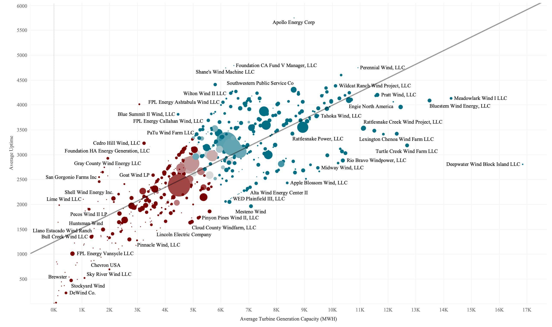
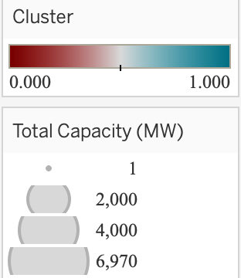
Operators show a distinct segregation based on their uptime performance.
Bigger is better and also more productive.
Both ends of the performance spectrum are dominated by small players. Larger players are more diversified and hence produce stable results
Cluster 1 (Teal) is more favorable as an investment opportunity
Each company is made up of a portfolio of plants hence the color gradient

Slide 24
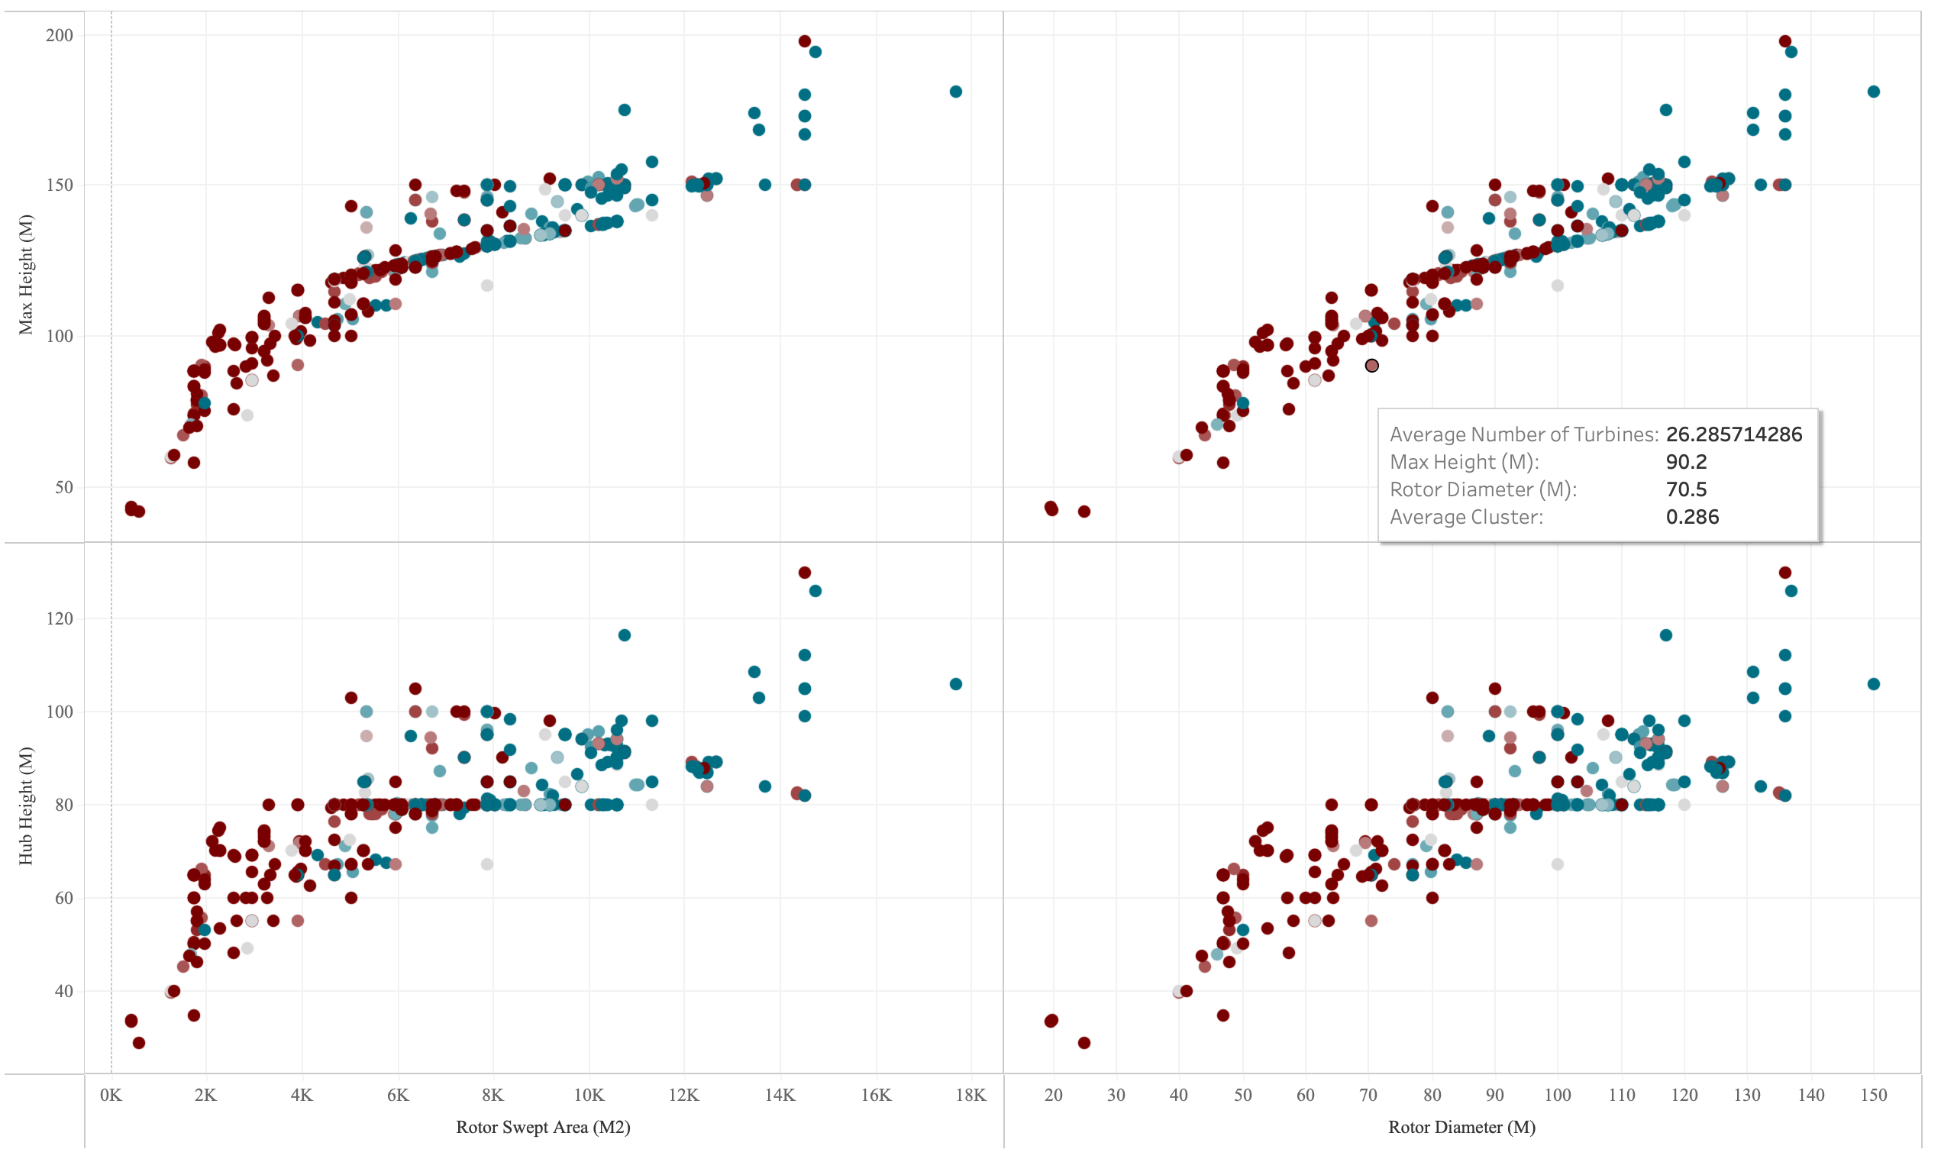
Operators with higher uptime use taller and bigger turbines
Bigger turbines are better and more productive. There is a clear correlation between turbine size and uptime.

Slide 25
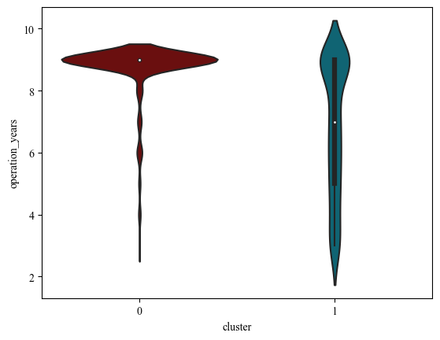
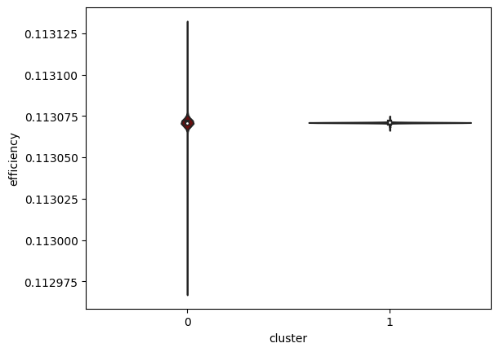
The clustering can also be a proxy for an amalgamation of plant features.
Most of the plants have been operational 9 years or older
Cluster 1 has little to no variation in efficiency
The weaker cluster (0) tends to have more plants that have been operationally longer and hence not running as often to its stated capacity
The weaker cluster (0) also tends to have a slight variation in efficiency
Notes:
Because the cluster is unable to identify companies who perform well historically for uptime and efficiency, we should manually identify them

Slide 26
Partner Selection & Investment Plan
Pitch Deck Tagline

Slide 27
Past M&A Activities
Deals ranged from USD250m - USD1.5b for wind farm capacity of 300 - 600 MW
2019
2022
April
September
October
November
December
USD773m
USD320m
USD277m
USD1.5b
USD250m
NextEra Energy Partners acquired 391MW capacity wind farm from Brookfield Renewable.
Enbridge acquired wind and solar energy portfolio from Tri Global Energy.
InfraRed Capital acquired 49% stake in 551MW capacity wind farm from Algonquin.
NextEra Energy Partners acquired wind and solar energy portfolio from NextEra Energy Resources.
Boralex acquired 50% stake in 447MW capacity wind farm from EDF Renewables North America

Slide 28
Acquisition Evaluation Metrics Threshold
Plant capacity below 600 MW to keep within a more manageable investment budget
Cluster with higher uptime and consumption rate (blue cluster)
At least 5% compounded annual growth in uptime rate across plants
No increase in compounded annual consumption rate across plants

Slide 29
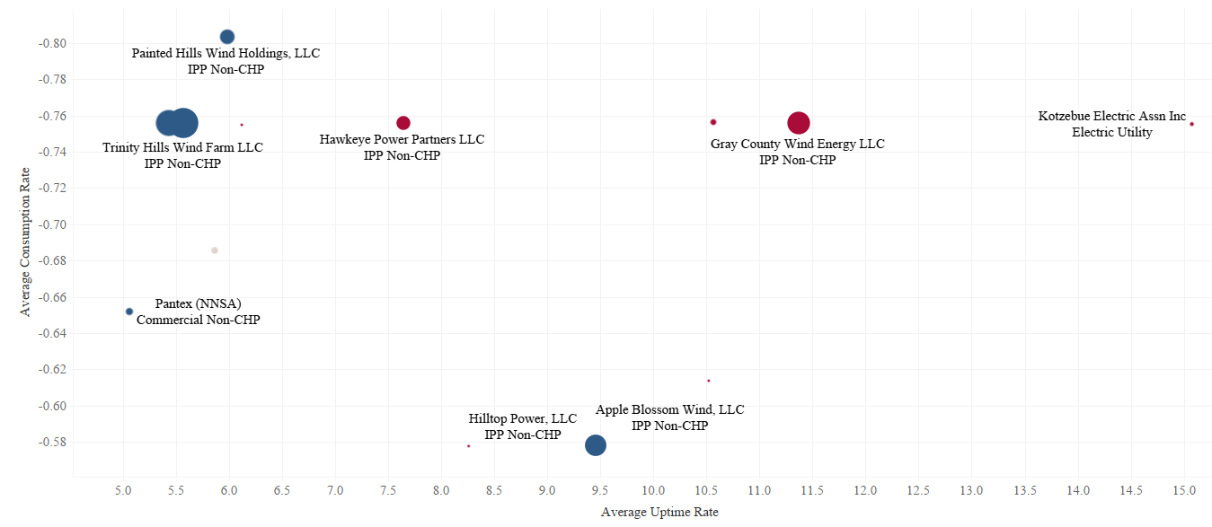
Partner companies are selected based on higher uptime rate and lower consumption rate
Targets based on Consumption Rate vs. Uptime Rate

Slide 30
Shortlisted targets ranked based on average uptime
Rank | Operator name | Owner | Total Farm Size (MW) | Average Uptime (MWh/MW) | Location
1 | FPL Energy Weatherford, LLC | Subsidiary of FPL Group, Inc | 147 | 4,235 | Oklahoma
2 | Trinity Hills Wind Farm LLC | Ares Management Corp. | 198 | 4,062 | Texas
3 | Pantex (NNSA) | Government owned (NNSA) | 12 | 3,773 | Texas
4 | Painted Hills Wind Holdings, LLC | Terra-Gen LLC (under PPA w Shell Energy) | 47 | 2,515 | California
5 | Apple Blossom Wind, LLC | AEP Renewables | 100 | 2,431 | Michigan

Slide 31
Potential roadmap through acquisition of operator
Exit in 5-10 years as the market grows
Repower older turbine through retrofitting (increase lifespan for ~5-10 years)
Plant expansion capitalising on operating management
Future establishment of hybrid farms

Slide 32
Reflection
What can we do better or more?

Slide 33
Future Work
Include more years of data into the historical performance analysis so that our dataset can be more robust
Look into data on turbine manufacturers and explore investment opportunities with them
Consider alternative case scenarios to analyse potential impact of state energy policies and population growth on the identified opportunities
Explore wind energy data from other countries to consider overseas investment opportunities

Slide 34
What we have learnt
Data cleaning and validation with large volume of data
Feature engineering
Data gathering and understanding
A data-driven approach in business decision-making
In-dept market research

Slide 35
THANK
YOU!
TEAM JADEN DAI01

Slide 36
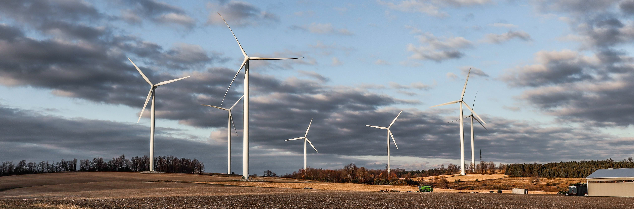
APPENDIX

Slide 37
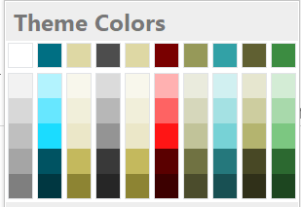
Colour Palette
#006F83 | #DED8A4 | #4D4D4D | #790000 | #CC6600
R: 0
G: 111
B: 131
R: 222
G: 216
B: 164
R: 77
G: 77
B: 77
R: 121
G: 0
B: 0
R: 204
G: 102
B: 0
#32A1A6 | #969959 | #606032 | #3C8C41 | #FFC000
R: 50
G: 161
B: 166
R: 150
G: 153
B: 89
R: 96
G: 96
B: 50
R: 60
G: 140
B: 65
R: 255
G: 192
B: 0

